Slide 1
Project 3
GROUP 12
Gao, Qing qg2175 Liu, Yuqiao yl4278 Wolansky, Ivan iaw2110 Yan, Xiyao xy2431 Zhu, Huizhe hz2657 (Presenter)

Slide 2
1. Identify the Task

Slide 3
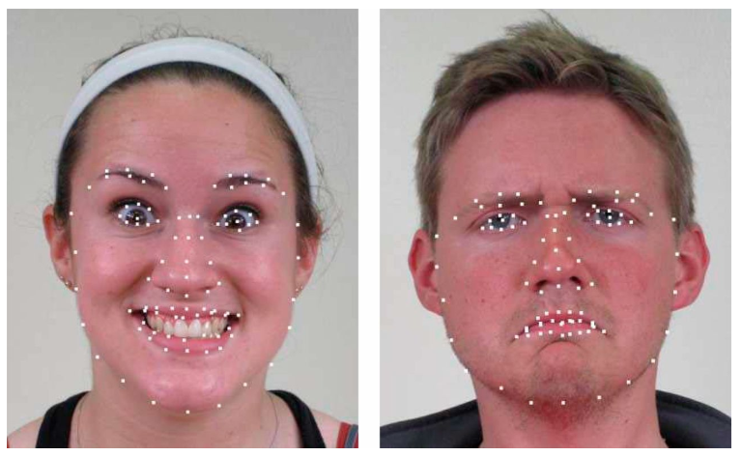
Task
Task: Identify facial expression from 22 emotions -> classification problem
What we have
2500 images (training data set), info about 78 fiducial points for each image
Build features: distances of fiducial points
3. What models
Linear based: Lasso, Ridge
Tree based: random forest
Mathematically: Support Vector Machine
Ensemble methods: Voting, Bagging, Gradient Boosting Machines
Notes:
SVM: significant accuracy with less computation power

Slide 4
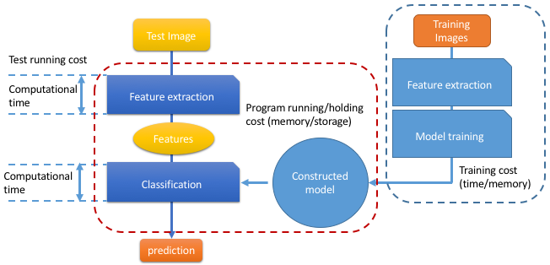
Structure

Slide 5
workflow
Feature extraction
Build baseline model
Build advanced models
Choose the best & build ensemble model
Notes:
what are the different ways to solve this classification problem

Slide 6
2. Build models

Slide 7

Feature extraction
Feature extraction in Python
Compute ‘Euclidean distance’ between fiducial points – 3003 features (78*77/2 = 3003)
Extract features from fiducial points, get X_train (features)
Extract responses from ‘label’ file Y_train = train_label[‘emotion_idx’]
File path: Spring2020-Project-group12/doc/Features Extraction --- R version.Rmd
Result:
Time for constructing features: 19.32 secs

Slide 8

Baseline model (gbm): 22.8%
Train model
gbm.baseline <- train_gbm(train.df=dat_train, s=0.001, K=2, n=50)
2. Predict on training and testing data
Pred_gbm_baseline <- test_gbm(gbm.fit=gbm.baseline, input.test=dat_test[, -6007], n=100)
3. Get accuracy score
score = mean(dat_test$label == pred_gbm_baseline)
4. Get estimated time training data
system.time(gbm.baseline <- train_gbm(train.df=dat_train, s=0.001, K=2, n=50))
Result:
Accuracy of GBM: 22.8%.
Time: 3.27 secs
Notes:
Convert weak learners to strong learners; each tree is grown on weighted data
Gradient boosting identify weak learners by loss function – allows user to optimize user specified cost function - good for real world application

Slide 9
voting classifier: 52%
Feature extraction
Train model:
estimators = [('svm', svm), ('ridge', ridge), ('logi', logistic)]
voting = VotingClassifier(estimators=estimators, voting='hard’) # majority vote
voting.fit(x_train_pca, y_train)
Predict on training and testing data
Test_pred = voting.predict(x_test_pca)
Train_pred = voting.predict(x_train_pca)
Get accuracy score
Train_score = accuracy_score(Y_train, train_pred)
Test_score = accuracy_score(y_validation, test_pred)
6. Get estimated time training data
Result:
Accuracy: 52.32%
Average time: 2.57 secs
Notes:
A Voting Classifier is a machine learning model that trains on an ensemble of different models and predicts an output (class) based on their highest probability of chosen class as the output.

Slide 10
bagging Classifier (SVM + PCA): 51.6%
Feature extraction
Set model parameters
Svm = SVC(kerner=‘linear’, C = 0.0001)
Svm_bag = BaggingClassifier(svm, n_estimators=500, n_jobs=-1, verbose=3)
Pca = PCA(n_components=128)
Apply pca
X_train_pca = pca.fit_transform(X_train)
4. Train model:
Svm_bag.fit(X_train_pca, y_train)
Predict on training and testing data
Get accuracy score
6. Get estimated time
Result:
Accuracy: 51.6%
Time: ~21.7 secs
Notes:
If samples are drawn with replacement, the method is known as Bagging
A Bagging classifier is an ensemble meta-estimator that fits base classifiers each on random subsets of the original dataset and then aggregate their individual predictions (either by voting or by averaging) to form a final prediction.

Slide 11
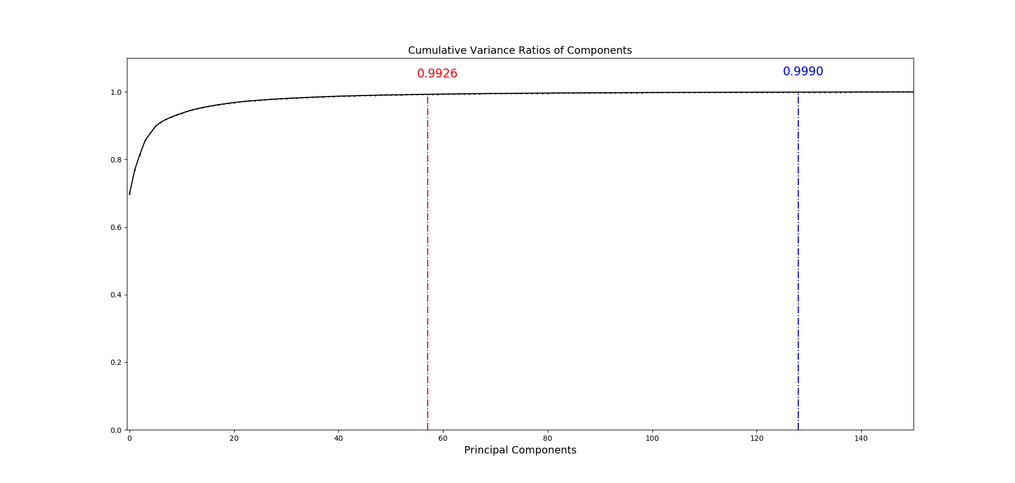
PCA: determine number of components
57
128
Notes:
If samples are drawn with replacement, the method is known as Bagging
A Bagging classifier is an ensemble meta-estimator that fits base classifiers each on random subsets of the original dataset and then aggregate their individual predictions (either by voting or by averaging) to form a final prediction.

Slide 12
Lasso: 54%
Regularization method 1: set the less contributive variables to 0 (fast)
Steps
Feature extraction
Change the type data, convert x_train to matrix of predictors, required by glmnet(), convert y_train to factor
Train model with 5-folds cross validation, find the best lambda defines shrinkage amount
cv.glmnet(x= X_train, y = y_train, family = ‘multinomial’, type.measure = ‘class’, nfolds = 5)
Specify alpha = 1
Result:
Accuracy: 54.28 %
Time: 15.4 min train model, 11.5 secs to test
Notes:
Lasso and Ridge regression penalize residuals; least important variables will be set to 0, parameter lambda -> larger, coefficients get smaller, more -> 0
Use glmnet package:

Slide 13
Ridge: 49.6%
Regularization method 2: set the less contributive variables close to 0
Steps
Feature extraction
Change the type data, convert x_train to matrix of predictors, required by glmnet(), convert y_train to factor
3. Train model with 5-folds cross validation, find the best lambda
cv.glmnet(x= X_train, y = y_train, family = ‘multinomial’, type.measure = ‘class’, nfolds = 5)
Specify alpha = 0
Result:
Accuracy: 49.58%
Time: 32.9 min train model, 12.7 secs to test

Slide 14
SVM + PCA: 50.8%
Feature extraction
train_pca, train SVM by the first 500 components
Svm(train_pca$x[ ,1:i], y = as.factor(data.train[ ,3004]))
3. Select the first 57th components (performs best on the validation set)
Model_svm<-svm_list[[57]]
4. Predict data and get accuracy
Result:
Accuracy: 50.8%
Time: > 3 hours

Slide 15
3. Summary

Slide 16
Model summary: Lasso works best
Baseline Model: GBM: 22.8% (3.27 min)
Voting Classifier: SVM + Ridge + Logistic Regression: 52.32%, (2.57 secs)
SVM with Bagging method: 51.6% (~21.7 secs)
Lasso: 54.28% (15.4 min) to train model
Ridge: 49.58% (32.93 min) to train model
PCA+SVM: 57 PCs, 50.8% accuracy (>3 hours for training model)
Notes:
ramdom guess(4.5%). Why lasso works best ?
we have 3003 features and most of them have very little contribution, by setting them to 0, we reduce the 'bad' impact of the useless features

Slide 17
In the end
To summarize:
Baseline model: 22.8%
Advanced models: 49.58% - 54.28%
Lasso performs the best
Final thoughts
Why lasso works best? too many features (3003), by setting less contributive features to 0
Why ensemble method does not work best? Bias may exist, from the dataset etc.

Slide 18
Thank you

